Slide 1
ENTERPRISE RESOURCE PLANNING AND ENTERPRISE APPLICATION INTEGRATION
Vinay karthik maradi balachandra [azf2ya]

Slide 2
What is ERP?
DEFINING ERP
ENTERPRISE RESOURCE PLANNING(ERP) is a cross functional enterprise system driven by an integrated suite of software modules that supports the basic internal business processes of a company

Slide 3
What is ERP?
The practice of consolidating an enterprise’s planning, manufacturing, sales and marketing efforts into one management system.
Combines all databases across departments into a single database that can be accessed by all employees.
ERP automates the tasks involved in performing a business process.

Slide 4
ENTERPRISE RESOURCE PLANNING
Consolidation of an organization's planning, production, sales, and marketing efforts into a single management structure.
Consolidates all departmental databases into a single account that all workers can access
ERP software automates the tasks required to complete a business process

Slide 5
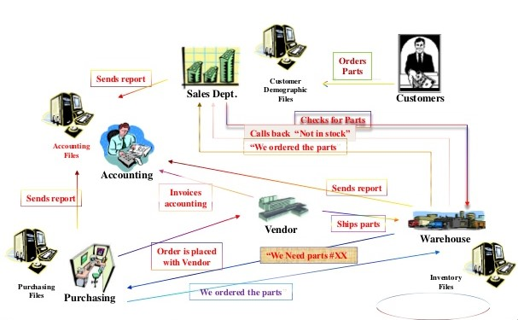
Before ERP Systems

Slide 6
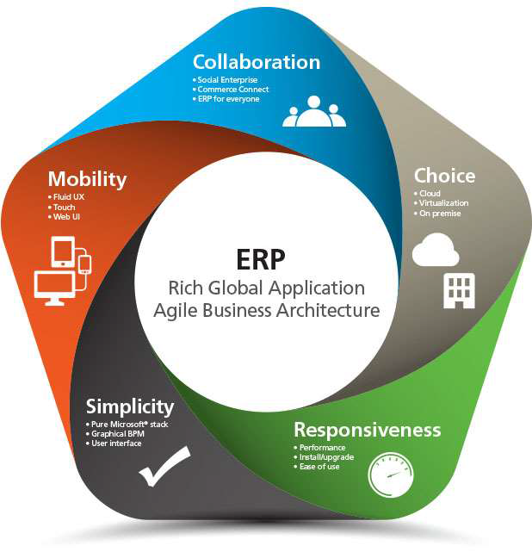
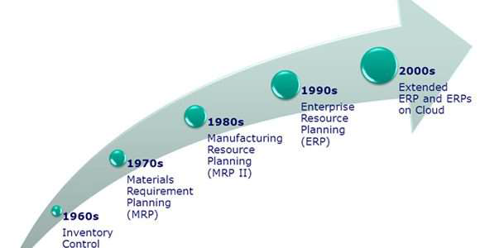
Evolution of ERP Systems

Slide 7
Evolution of ERP Systems
Inventory Management & Control-1960’s
Inventory Management and control is the combination of information technology and business processes of maintaining the appropriate level of stock in a warehouse. The activities of inventory management include identifying inventory requirements, setting targets, providing replenishment techniques and options, monitoring item usages, reconciling the inventory balances, and reporting inventory status.

Slide 8
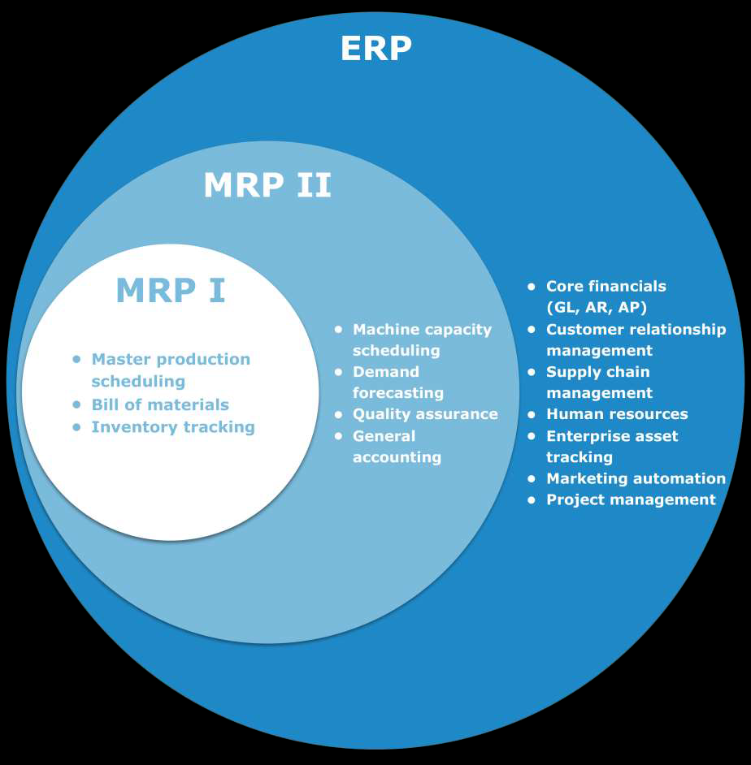
Evolution of ERP Systems
Material Requirement Planning (MRP)-1970’s
Materials Requirement Planning (MRP) utilizes software applications for scheduling production processes. MRP generates schedules for the operations and raw material purchases based on the production requirements of finished goods, the structure of the production system, the current inventories levels and the lot sizing procedure for each operation
Manufacturing Requirements Planning (MRP II)-1980’s
Manufacturing Requirements Planning or MRP utilizes software applications for coordinating manufacturing processes, from product planning, parts purchasing, inventory control to product distribution.

Slide 9
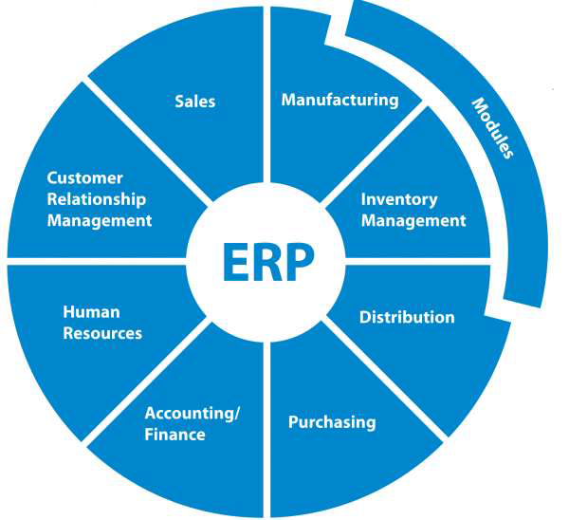
ERP Evolution

Enterprise Resource Planning (ERP)-1990’s
Enterprise Resource Planning or ERP uses multi-module application software for improving the performance of the internal business processes. ERP systems often integrates business activities across functional departments, from product planning, parts purchasing, inventory control, product distribution, fulfillment, to order tracking. ERP software systems may include application modules for supporting marketing, finance, accounting and human resources.

Slide 10

FUTURE OF ERP SOFTWARE
1. IoT (Internet of things)
The Internet of Things has been already taking the world by storm. It is an ecosystem of connected physical objects that can communicate with each other and can be accessible via the internet. So, any device which is a part of IoT can communicate to the ERP system. Moreover, these IoT devices can deliver all the relevant data including location, performance and other information required for the ERP application without the need of humans.
2. Big Data Analytics
An ERP software records a massive amount of data and this information remains unused for the maximum benefits. With the increasing use cases, this data generation is ready to grow exponentially. ERP integrated with Big Data analytics tool can use this data to make accurate predictions, better business strategies and intelligent decisions. This way, big data analytics tools can reshape the future of ERP.

Slide 11
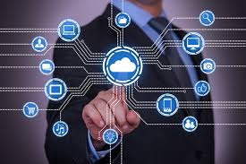
FUTURE OF ERP SOFTWARE
3. Wearable Technologies
The wearable technology market has become a hot topic of discussion among many marketers. Based on a report from Juniper Research, the wearable technology market is estimated to reach $68.7 million worth by 2019. For example, Augmented Reality glasses allows for hands-free operations that can be a gift to many blue collar workers. Even smart watches show a step forward compared to PDAs and smartphones because they are more easily accessible. Moreover, these watches have very fewer chances to be lost and dropped.
4. Cloud Technology
For the past 3 decades, legacy and on premise ERP systems have dominated the global ERP market. The in-house ERP technology is not capable enough to take advantage of the latest trends and technologies because their platform does not support it.
In the world of internet and cloud technologies, we will definitely see a paradigm shift in ERP systems. Cloud ERP solutions are all set to take over in ERP world as they are faster and support future updates. In fact, Cloud ERPs are flexible and have capabilities to support the latest technologies.

Slide 12
Typical Business Process :
Key observation
A typical enterprise has many Departments/ Business units(BU).
These Departments/ BU continuously communicate and exchange data with each other.
The success of any organization lie’s in effective communication and data exchange within the Departments/ BU as well as associated third party such as Vendors, Outsourcers and Costumers.
Also known as Decentralized System.

Slide 13
Problems with Decentralized
System
Numerous disparate information system are developed individually over the time.
Integrating the data becomes time and money consuming. Inconsistences and duplication of data.
High inventory, material and human resource cost.

Slide 14
Benefits of Centralized
System
Eliminates the duplication, discontinuity and redundancy in data.
Provides information across departments in real time.
Provides control over various business processes.
Increase Productivity, better inventory management, promotes quality, reduced material cost, boosts profits.
Better Customers interaction, increased throughput, improves customer services.

Slide 15
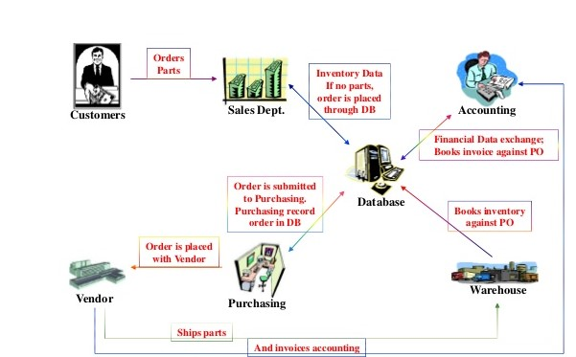
Centralized ERP System

Slide 16
Centralized System :
Key observation
Data is maintained at a central location and is shared with various Departments.
Departments have access information/data of the other Departments

Slide 17
ERP Application Components
ERP
FINANCIAL MANAGEMENT
BUSINESS INTELLIGENCE
SUPPLY CHAIN MANAGEMENT
HUMAN RESOURCE MANAGEMENT
MANUFACTURING OPERATIONS
INTEGRATION

Slide 18
ERP Components
Financial Management
At the core of ERP are the financial modules, including general ledger, accounts receivable, accounts payable, billing and fixed asset management. If your organization is considering the move to an ERP system to support expansion into global markets, make sure that multiple currencies and languages are supported, as well as regulatory compliance in the U.S. and in foreign countries.
Other functionality in the financial management modules will include budgets, cash-flow, expense and tax reporting. The evaluation team should focus on areas that are most important to support the strategic plans for your organization.

Slide 19
ERP Components
Business Intelligence
Business Intelligence (BI) has become a standard component of most ERP packages. In general, BI tools allow users to share and analyse the data collected across the enterprise and centralized in the ERP database. BI can come in the form of dashboards, automated reporting and analysis tools used to monitor the organizational business performance. BI supports informed decision making by everyone, from executives to line managers and accountants.

Slide 20
ERP Components
Supply Chain Management
Supply Chain Management (SCM), sometimes referred to as logistics, improves the flow of materials through an organization by managing planning, scheduling, procurement, and fulfillment, to maximize customer satisfaction and profitability. Sub modules in SCM often include production scheduling, demand management, distribution management, inventory management, warehouse management, procurement and order management..

Slide 21
ERP Components
Human Resource Management
Human resource management ERP modules should enhance the employee experience – from initial recruitment to time tracking. Â Sub modules can include payroll, performance management, time tracking, benefits, compensation and workforce planning. Self-service tools that allow managers and employees to enter time and attendance, choose benefits and manage PTO are available in many ERP solutions.

Slide 22
ERP Components
Manufacturing Operations
Manufacturing modules make manufacturing operations more efficient through product configuration, job costing and bill of materials management. ERP manufacturing modules often include Capacity Requirements Planning, Materials Requirements Planning, forecasting, Master Production Scheduling, work-order management and shop-floor control

Slide 23
ERP Components
Integration
Key to the value of an ERP package is the integration between modules, so that all of the core business functions are connected. Information should flow across the organization so that BI reports on organization-wide results.

Slide 24
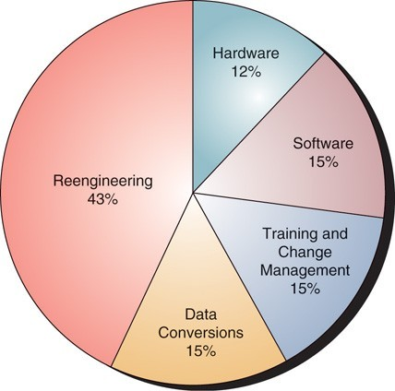
Costs of ERP

Slide 25
High Level Summary Costs of 3 Different On-Premise Scenarios
3 CONCURRENT USERS
7-10 CONCURRENT USERS
This scenario is about $60,000-$90,000 (software & implementation services. Hardware is extra).
12-15 CONCURRENT USERS
This scenario is about $120,000-$180,000 (software & implementation services. Hardware is extra).
This scenario is about $20,000-$30,000 (software & implementation services. Hardware is extra).
FINANCIALS, SALES & INVENTORY FUNCTIONALITY
FINANCIAL MODULES ONLY
FINANCIALS, SALES, INVENTORY FUNCTIONALITY

Slide 26
ERP Project and Time
Real transformational ERP efforts will usually run between 1 to 3 years, on average.
Short implementations (3 to 6 months) can be achieved for small companies or if implementation is limited to a small area of the company, or if the company only used the financial pieces of the ERP system.
The important thing is not to focus on how long it will take but to understand why you need ERP and how you will use it to improve your business.

Slide 27
Hidden Costs of ERP
Training
Integration and testing
Data conversion
Data analysis
Consultants
Replacing best and brightest staff after implementation
Implementation teams can never stop
Waiting for ROI
Post-ERP depression

Slide 28
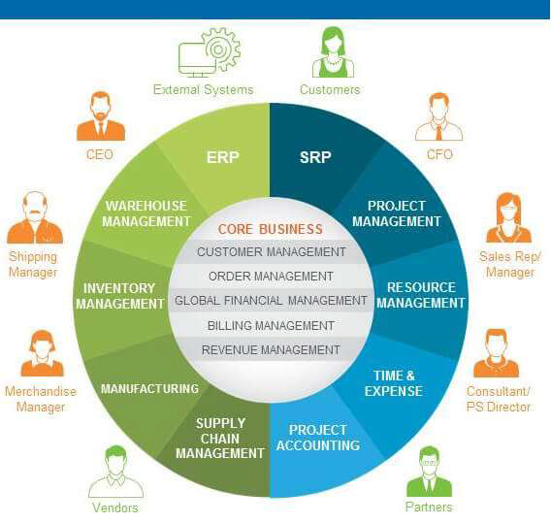
Benefits of ERP Systems
Improving integration, flexibility
Fewer errors
Improved speed and efficiency
More complete access to information
Lower total costs in the complete supply chain
Shorten throughput times
Sustained involvement and commitment of the top management

Slide 29
Benefits of ERP Systems
Reduce Stock To A Minimum
Enlarge Product Assortment
Improve Product Quality
Provide More Reliable Delivery Dates And Higher Service To The Customer
Efficiently Coordinate Global Demand, Supply And Production

Slide 30
Drawbacks of ERP System
The cost of ERP Software, planning, customization, configuration, testing, implementation, etc. is too high.
ERP deployments are highly time-consuming – projects may take 1-3 years (or more) to get completed and fully functional.
Too little customization may not integrate the ERP system with the business process & too much customization may slow down the project and make it difficult to upgrade.
The cost savings/payback may not be realized immediately after the ERP implementation & it is quite difficult to measure the same.

Slide 31
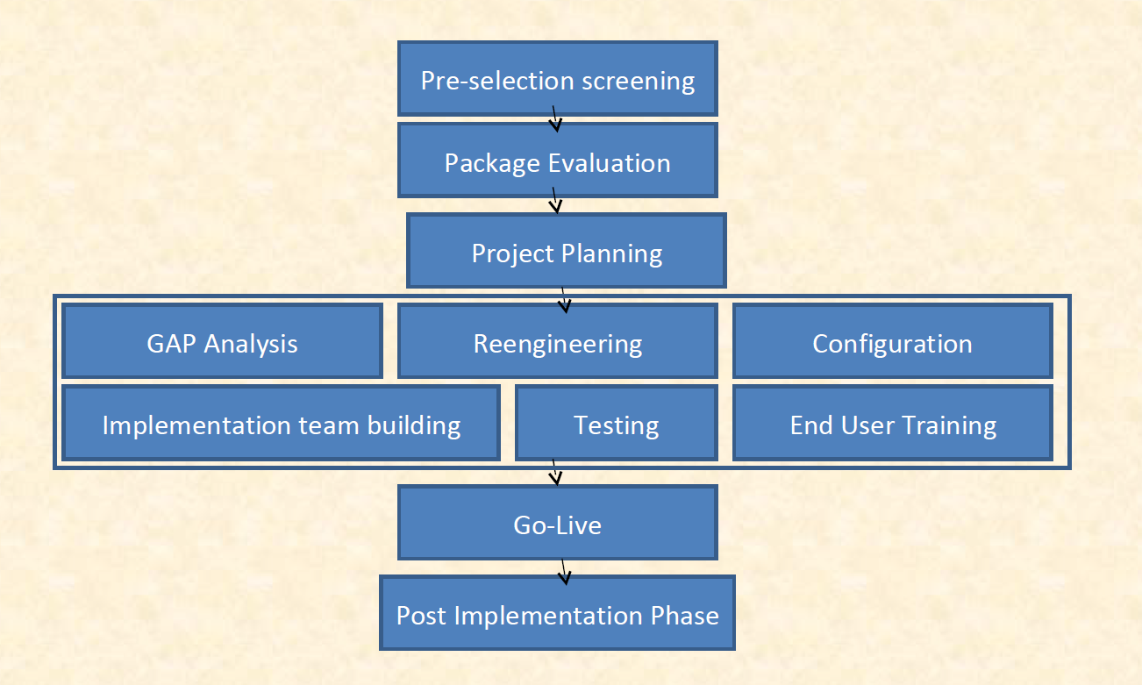
ERP Implementation Life Cycle

Slide 32
ERP Implementation
Phases
MAJOR PHASES OF IMPLEMENTATION
Concept/initiation
Development
Implementation
Closeout/Operation and maintenance

Slide 33
Risks with ERP
Implementation
Expensive (can costs 100 thousands to millions of dollars)
Time-consuming (can take months to years)
Great risk for the organization
Transfer of Knowledge Acceptance with the company

Slide 34
Causes of ERP Failures
Business mangers and IT professionals underestimate the complexity of the planning, development, and training needed
Failure to involve affected employees in the planning and development phases
Trying to do too much too fast in the conversion process
Failure to do enough data conversion and testing

Slide 35
Best Practices of ERP Implementation
Change Management
Extensive Education And Training
Data Clean Up And Data Integrity
Implementation Is Viewed As An Ongoing Process

Slide 36
Best Practices of ERP Implementation
Change Management
Changes in business procedures, responsibilities, work load. As a result, ERP implementations are times of high stress, long hours, and uncertainty.
Mid-level managers must facilitate continual feedback from employees, provide honest answers to their questions, and help resolve their problems.

Slide 37
Best Practices of ERP Implementation
Extensive Education and Training
General education about the ERP system for everyone.
Massive amount of end users training before and during implementation.
Follow-up training after the implementation.
10 to 15% of total ERP implementation budget for training will give an organization an 80% chance of a successful implementation.

Slide 38
Best Practices of ERP Implementation
Data Clean up and Data Integrity
Clean-up data before cut-over.
“Near enough is no longer good enough.”
To command trust, the data in the system must be sufficiently available and accurate.
Eliminate the old systems, including all informal systems.

Slide 39
Best Practices of ERP Implementation
Implementation is viewed as an ongoing process
Ongoing need for training and software support after implementation.
Ongoing need to keep in contact with all system users and monitor the use of the new system.
Ongoing process of learning and adaptation that continually evolves over time.

Slide 40
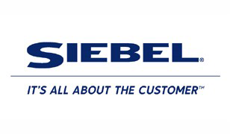


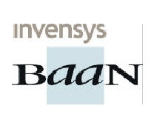


Main ERP vendors
ERP Market consists of the big 4 vendors (Sap, Oracle PeopleSoft, Baan, JD Edwards) and others.
The big 4 account for 61% of the market share.

Slide 41
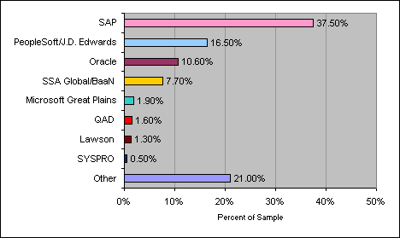
Market Analysis of ERP Vendors

Slide 42
ORACLE PEAOPLESOFT
Oracle’s Warehouse Technology Initiative provides customers with a complete data
warehousing solution.
Oracle’s Integrated Business Intelligence Solutions deliver powerful capabilities to
users anywhere in the enterprise, at any time. Products include Oracle Reports,
Oracle’s Enterprise Reporting Tool, Oracle Discoverer, Oracle’s Query and Analysis
tool etc.
Oracle Applications is a leading provider of packaged and integrated front office
ERP solutions for the enterprise follows internet computing model.
Oracle has 45+ modules divided into following categories
• Oracle Financials
• Oracle Human Resource
• Oracle Projects
• Oracle Manufacturing
• Oracle Supply Chain
• Oracle Front Office

Slide 43
SAP
SAP (Systems, Applications and products in Data Processing)
SAP ERP packages come in two versions: the mainframe version (SAP R/2) and the client/server version (SAP R/3)
SAP products feature a sophistication and robustness unmatched by other business software solutions.
SAP has developed an extensive library of more than 80 predefined business processes, spanning each functional software requirement.

Slide 44
BAAN
The Baan series-based product family includes Baan
Enterprise Resource Planning (Baan ERP), Baan Front
Office, Baan Corporate Office Solutions, Baan Supply Chain
Solutions etc.
Baan serves a number of industries like Aerospace & Defense
and Automotive.
The Baan ERP modules include the following
• Manufacturing
• Finance
• Project
• Distribution

Slide 45
JD EDWARDS
JD Edwards WorldVision is a thin client bridge that provides the Graphical User Interface (GUI) with a look and feel common to the PC, while protecting your investment in WorldSoftware and the AS/400. The different product modules available from JD Edwards are:
• Foundation Suite
• Financial Suite
• Logistics/Distribution Suite
• Services Suite
• Manufacturing Suite
• Architecture, Engineering, Construction, Mining and Real Estate Suite
• Energy and Chemical Suite
• Payroll Suite
• Human Resource Suite
• Customer Service Management Suite
• Government, Education, and Not-for-profit Solutions
• Utility and Energy Solutions

Slide 46
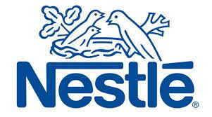
NESTLE CASE STUDY
33 manufacturing facilities, 6 distribution centers and 17sales offices around the country, 17,300 employees nationwide
Nestle USA’s brands were paying 29 different prices for vanilla -to the same vendor.
Nine different general ledgers and 28 points of customers entry.

Slide 47
NESTLE CASE STUDY
$210 million budget
Five SAP Modules –purchasing, financials, sales and distribution, accounts payable and accounts receivable
50 top business executives and 10 senior IT professionals.
Transforming the separate brands into one highly integrated company.
Internal aligned and united, establishing a common business process architecture
Standardizing master data
The new business process confused most of employees, then resistance grew into rebellion in 2000.
Reconstructed in June 2000 and completed in 2001.

Slide 48
NESTLE CASE STUDY
Common database and business processes lead to more trustworthy demand forecast.
A comprehensive account planning tool.
Nestle can now forecast down to the redistribution center level.
Nestle has improved forecast accuracy by 2%
Higher factories utilization
fewer factories = big gains in factories Utilization
Reduce inventory level

Slide 49

AGILENT TECHNOLOGY CASE STUDY
Oracle’s Business Suite software,
Started in September 2000 till 2004,
Approximately100 Oracle consultants to install the program
“One IT” organization
Supply chain capability
Migrating 2,200 legacy applications that it inherited from HP to Oracle
IT spend was 8-10% of sales
•80% for business operations
•20% maintenance& upgrading Old systems
Further autonomy over the IT portfolio would have led to 50% cost increase.

Slide 50
AGILENT TECHNOLOGY CASE STUDY
GOALS
To consolidate a large number of independent operating groups into a single worldwide IT function,
To share information quickly and efficiently
To drive the operational costs down by more than 20%,
To combine all IT budgets
Migrating from all existing ERP systems to a single Oracle-based infrastructure system
The use of bar code for materials received from suppliers
The use of Evaluated Receipt Settlement (ERS)
Real-time information about inventory and order status,
Easier to understand invoicing and pricing,
Improved visibility on product delivery lead time.

Slide 51
AGILENT TECHNOLOGY CASE STUDY
PROBLEMS
Because of the consolidation of its 2,200 software systems to under 20,confusion meant lost order and revenue
Mistakes converting backlog.
“The other problem we had was converting backlog from legacy to new systems, especially for our highly configured products in our test and measurement operation.”
Extra $35 million to cover costs of ERP and CRM rollout.
ERP implementations are a lot more than software packages.
People, processes, policies and culture are all factors that should be taken into consideration when implementing a major enterprise system.
ERP disasters are often caused by a user company itself.

Slide 52
INTEGRATED ENTERPRISE APPLICATION
DEFINITION
Enterprise application integration (EAI) is the process of connecting databases and workflows associated with business applications so that the information is used uniformly across the organization and that improvements to core business data made by one application are correctly mirrored in others.
In other words, EAI is defined as “the unrestricted sharing of data and business processes among any connected applications and data sources in the enterprise.”

Slide 53
Defining EAI
Why EAI?
The functionality of an Enterprise would be simplified if everyone used the same servers with the same operating system with the same clients.
Reality is very diverse. We can expect a mix of mainframes, Windows, UNIX, Linux, VMS, as well as many other systems
Getting them to work/share data together is the issue!
Using EAI effectively will allow us to integrate without making major changes to our current infrastructure.
What is EAI?
Integrates applications and enterprise data sources so that they can easily share business processes and data
Integration is done without significant changes of applications and data sources
3/31

Slide 54
OPERATIONS IN AN ENTERPRISE
MANUFACTURING
PROCESS – SIMPLE/
PRODUCTS
TOOLS
MANUFACTURING OPERATIONS MANAGEMENT EG AIRCRAFT MANUFACTURING
STRUCTURE OF MANUFACTURING OPERATION
MANUFACTURING CELL CYCLE
INTEGRATED MANUFACTURING SYSTEM
ASSEMBLING

Slide 55
TYPES OF PRODUCTION
SUPPLY
BASED ON THE USES
PART PRODUCTION
HIGH QUANTITY
UNIQUE PRODUCTION
MASS PRODUCTION
TO PUSH THE PRODUCT
TO PULL THE PRODUCT

Slide 56
PRODUCTION TASKS
PLACE OF PRODUCTION
TECHNOLOGY TO BE USED
SURVEYING THE DEMAND
MATERIAL REQUIREMENT PLANNING
QUANTITY REQUIREMENT PLANNING
IMPLEMENTATION:
MATERIAL REQUIREMENT
QUANTITY REQUIREMENT
PRODUCTION MONITORING AND TRACKING

Slide 57
ORGANIZATIONAL REQUIREMENTS
PRODUCT DESIGN AND TECHNOLOGY
PRODUCTION PROCESS PLANNING
QUALITY INSPECTION AND CONTROL
PIECE PRODUCTION

Slide 58
CONTROLLING OPERATIONS
PRODUCTION CONTROL
PLANNING
MATERIAL REQUIREMENTS
OPERATIONAL PROGRAM
LOAD ON PRODUCTION EQUIPMENT
MANUFACTURING PROCESS INITIATION
WORKSHOP LEVEL CONTROL
WORK COSTS, PAYMENTS
MATERIAL COSTS
EVENT SUCCESS/FAILURE

Slide 59
Architectures
University of Education Okara
1 Layer Architecture
Monolithic information systems
Presentation, application logic, and resource management were merged into a single tier
2 Layer Architecture
Separation of presentation layer from other 2 layers (app + resource)
Became popular as 'server/client' systems
3 Layer Architecture
Can be achieved by separating Resource Management from application logic layer
4/31

Slide 60
Multi-tier Architectures
In software engineering, multitier architecture, often referred to as n-tier architecture is a client–server architecture in which presentation, application processing, and data management functions are physically separated.
The most widespread use of multitier architecture is the three-tier architecture.
6/31

Slide 61
Multi-tier Architectures
Business Logic is applied in the middle tier, and is Independent of the rest of the tiers.
Data-tier application is a logical database management entity that defines all of the SQL Server objects - like tables, views, and instance objects
Client Tier user interfaces
Middle tier business logic
Data tier data sources
Web browsers HTML, Java
Middleware Server
e.g. Web server
Databases
GUI clients C++, VB, Java
Legacy Systems
7/31

Slide 62
Middleware
Allows communication
Through a standard language
Across different platforms
Between legacy and modern applications
Takes care of
Transactions between servers
Data conversion
Authentication
Communications between computers
8/31

Slide 63
Middleware
Main use today: covering thin client architectures (heavily server dependent)
Common Object Request Broker Architecture (CORBA) is used in Middleware during implementation
CORBA enables communication between software written in different languages and running on different computers.
EJB (Enterprise JavaBeans) is a subset of the Java EE specification that achieves the same goals as CORBA.
User interfaces
Client-tier (GUI applications, browsers)
Business logic
Middle-tier (CORBA/EJB)
Data sources
Data-tier (databases, mainframes)
9/31

Slide 64
EAI
MIDDLEWARE AND EAI
Middleware
Middleware
Middleware
Middleware
Middleware
Middleware

Slide 65
ERP System
EAI IN IMPLEMENTATION
Internal Applications (Java,C,C++)
CRM System
Enterprise Portal Application
EAI
Databases
Financial System
Legacy System
Suppy Chain Mgt System

Slide 66
EAI BENEFITS:
Lower development costs
Integration is simpler because systems are more loosely coupled than in object brokers
Lower opportunity costs
Integration is done more quickly
corresponding cost savings reachieved sooner
Lower maintenance effort
adapters extract the interaction with external systems
significant advantage from the software engineering point of view
13/31

Slide 67
Conclusion
ERP:
Reduction on inventory costs; Reduction on raw material costs.
Lead-time for customers, production time, and production costs can be reduced.
Drawback is that the cost of implementing can be quite high and risks are great.
EAI:
Enterprises integrate their applications
They are less expensive than replacement
They are more efficient than information islands
Enterprises must establish web-presence and make business services available to web-clients
15/31

Slide 68


